Slide 1
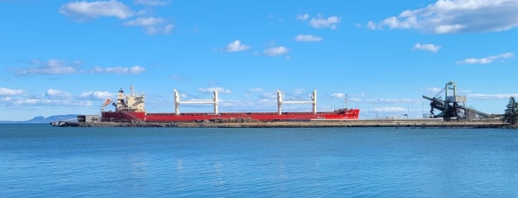
Year in Review
Mission to Seafarers:
Port of Thunder Bay
The Rev’d Canon Ed Swayze
Chaplain
Notes:
Power Point – Year in Review
Federal Dee at TBT

Slide 2
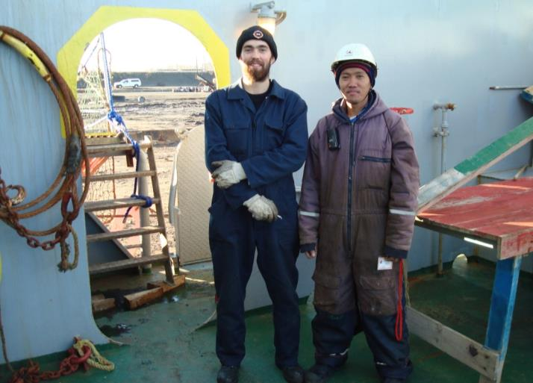
Seafarers - Foreign
Deck crew
earn: $1,400
US a month
Length of
contract:
6 to 13 months
Time ashore: approx 4 days out of 78 days (2½ months)
Notes:
Canadian crew make over $5,000 per month

Slide 3
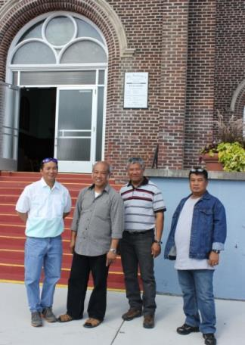
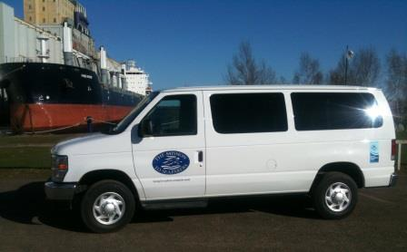
Van
Transport seafarers to
Seafarers’ Centre and
shopping
Take seafarers to mass
Free of charge,
donations accepted
2014 Ford Econoline
Wagon
Notes:
Donations fund van ministry

Slide 4
Transportation
Large port geographically
  2 hours round trip to drive it
  challenge for ministry
  some berths over $150 for a taxi round trip
Opportunity to connect with seafarers, they know someone cares about them and we assist them
Notes:
Challenge for ship visiting

Slide 5
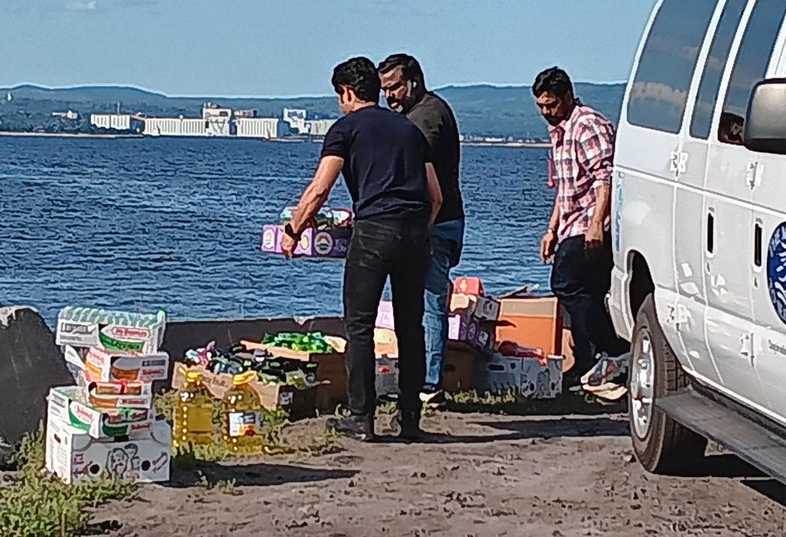
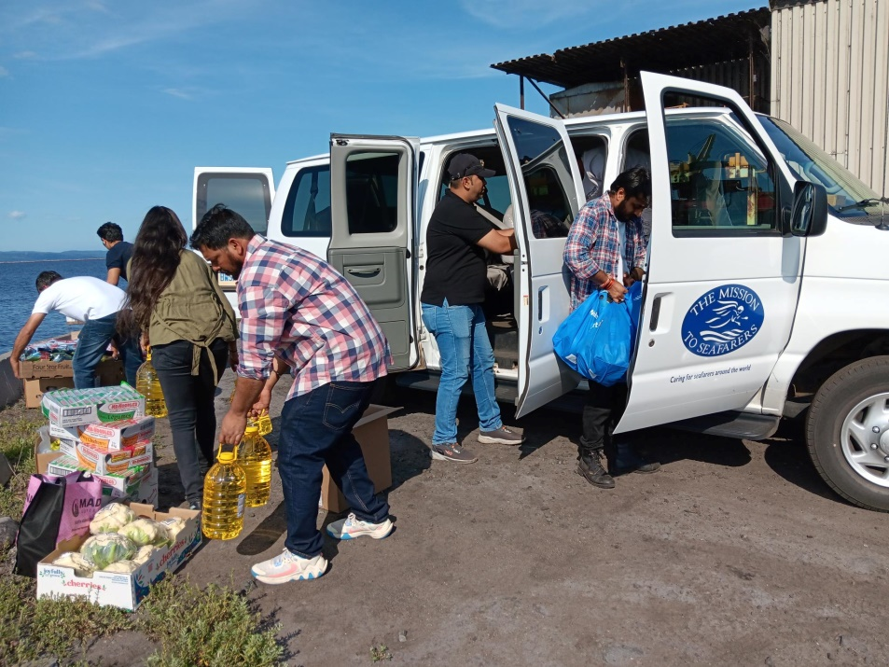
Transportation
Notes:
Elbeborg at Thunder Bay Terminals
Hanseatic Inspiration at the Cruise Ship Dock
provisions

Slide 6
Transportation
Value added over a taxi:
  In contact with the ship’s agent, keeps him informed and resolves problems
  For crew change, deal with problems:
  late flights, lost luggage, registering at hotel
  For medical, assist with registering at the hospital, pay report fee, purchase prescriptions

Slide 7
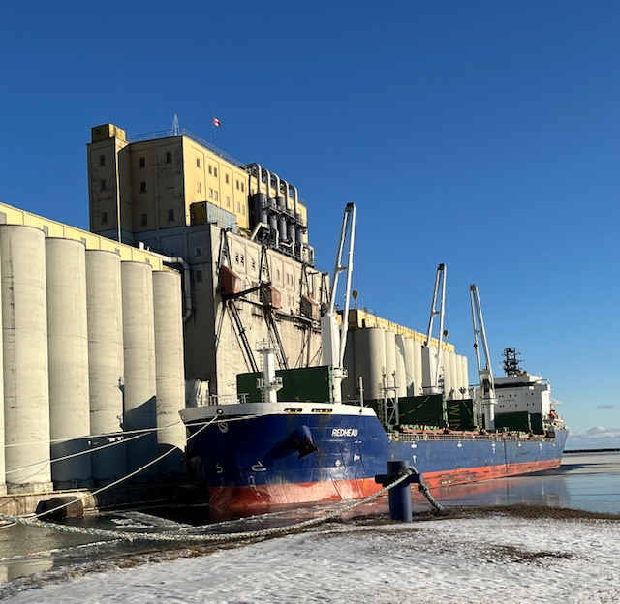
Ships in Port
 | 2025 | 2024
Foreign | 152 | 189
Canadian | 327 | 308
US | 9 | 7
Total | 488 | 504
Notes:
Redhead

Slide 8
How did we do?

Slide 9
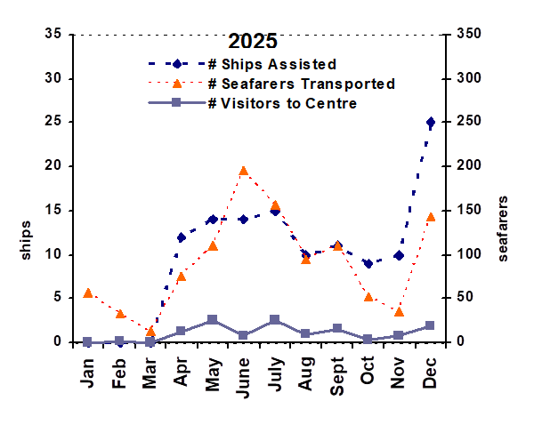
How did we do in 2025?

Slide 10
How did we do in 2025?
Open 161 out of 243 nights in the season (66%)
Assisted 120 ocean-going ships (87%)
1,070 seafarers transported
128 seafarers visited our Centre
Christmas Gift Bags: delivered
468 gift bags, including 3 for women, to 26 ships
Notes:
Not assisting cruise ships
Layby discharge & loading

Slide 11
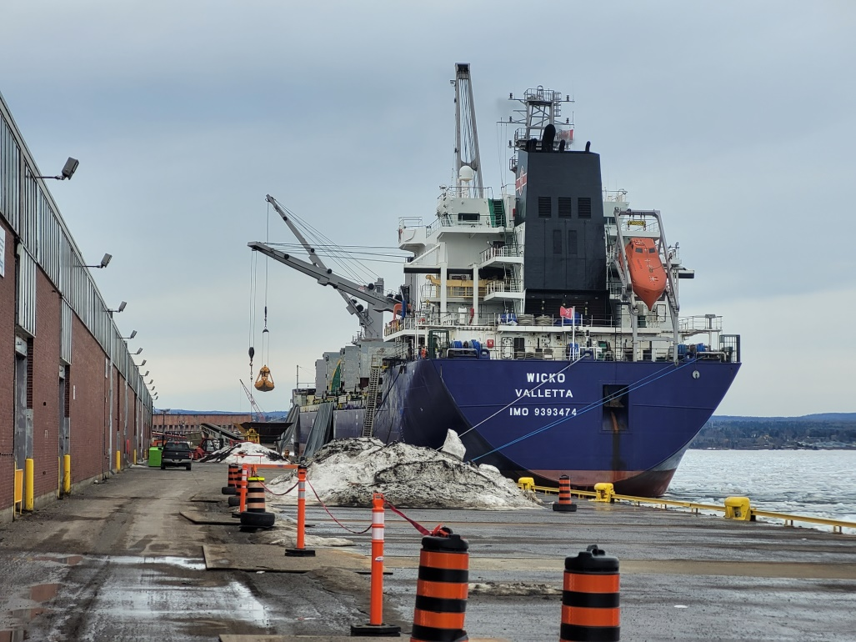
Fertilizer
Nitrogen (N) – ammonium nitrate
  also an explosive
Phosphorus (P) – phosphate rock
Potassium (K)
– potash
Notes:
M/V Wicko discharging Phosphate rock from Morocco

Slide 12
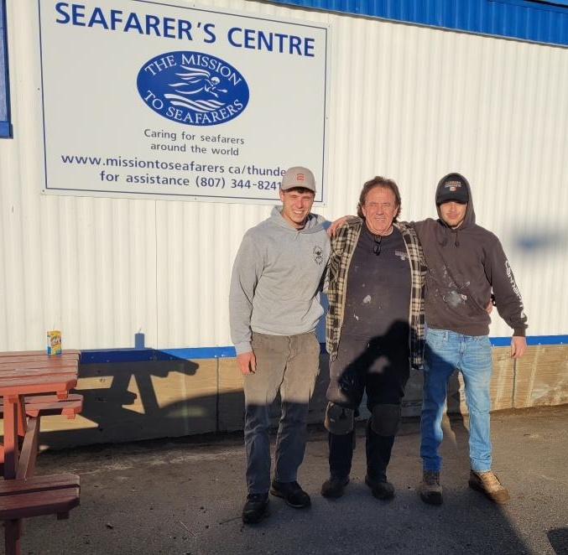
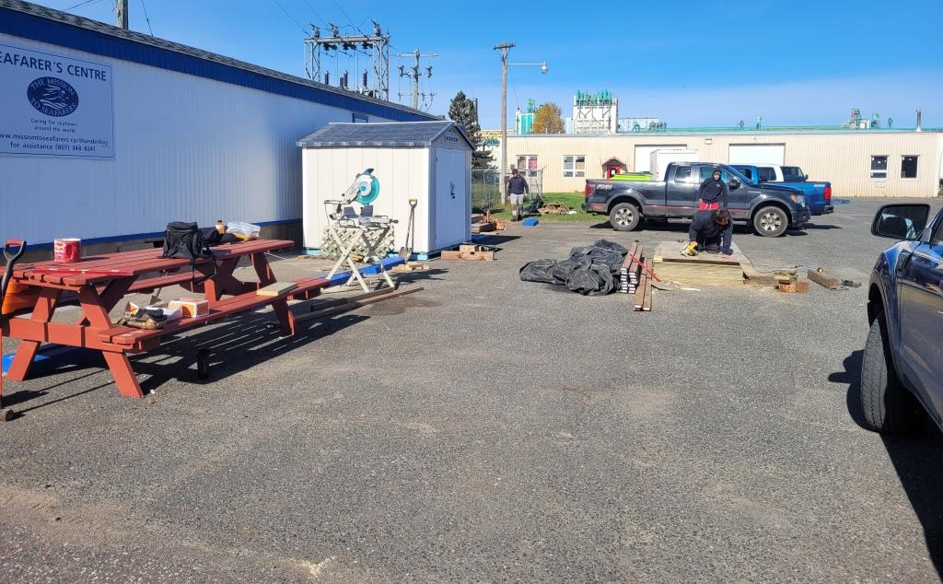
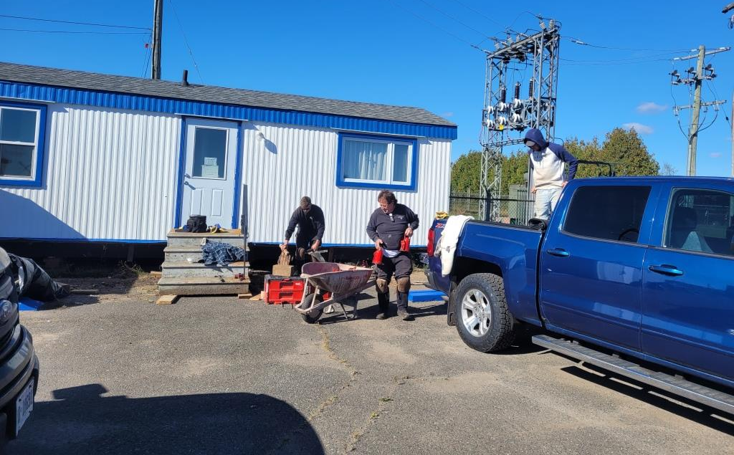
Skirting Project
Replace blocking and skirting, and insulate
Thank you to donors
and
Massaro Construction
Notes:
Seafarers Centre good for a generation

Slide 13
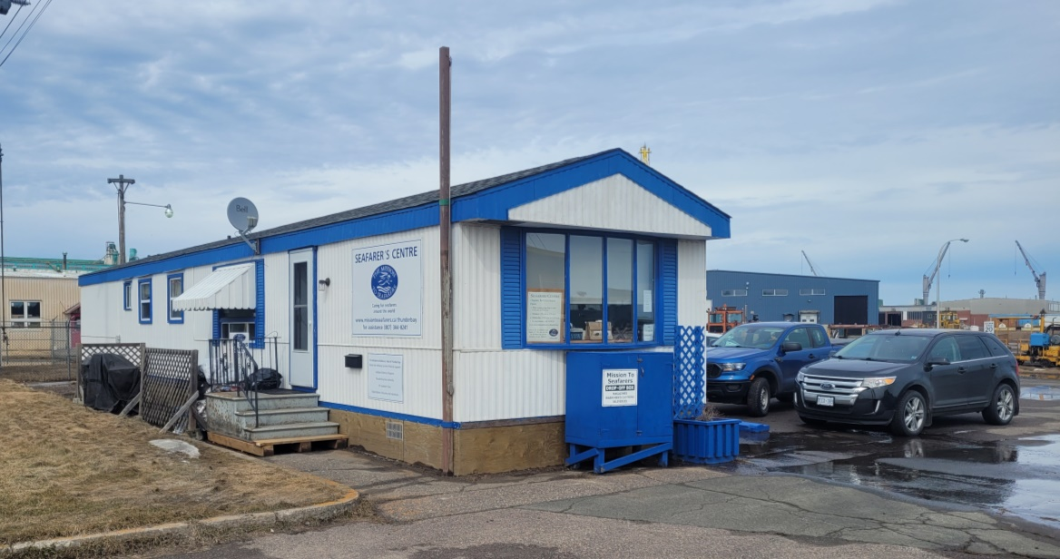
Capital Repairs
2019 Roof
2020 Furnace
2024 Water Heater
2025 Skirting
Notes:
Good for a generation

Slide 14
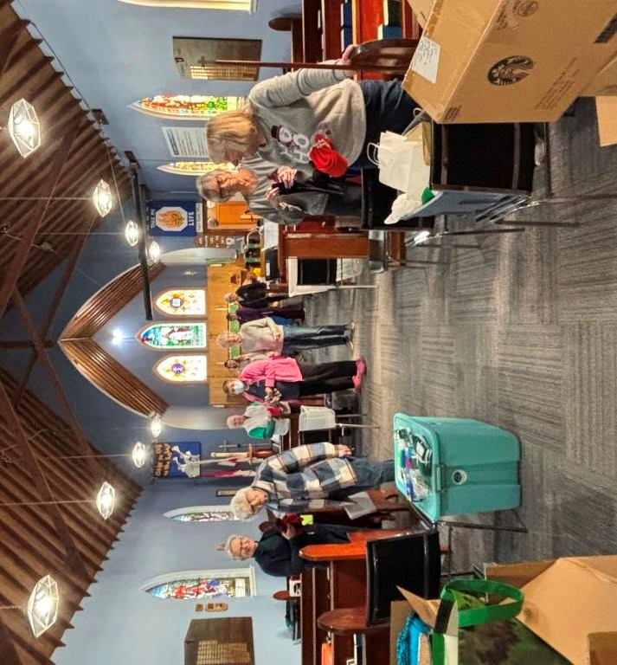
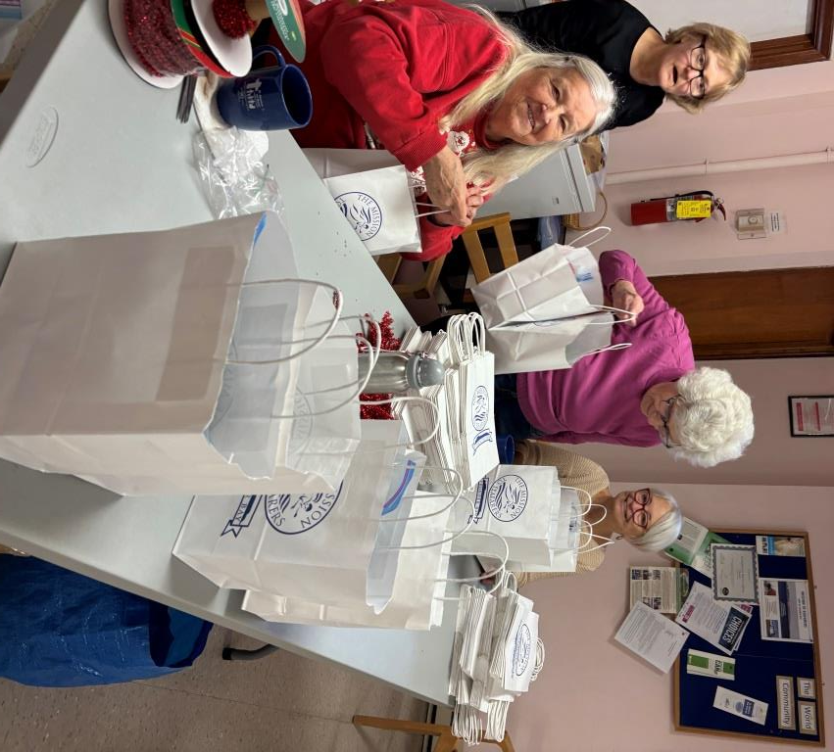
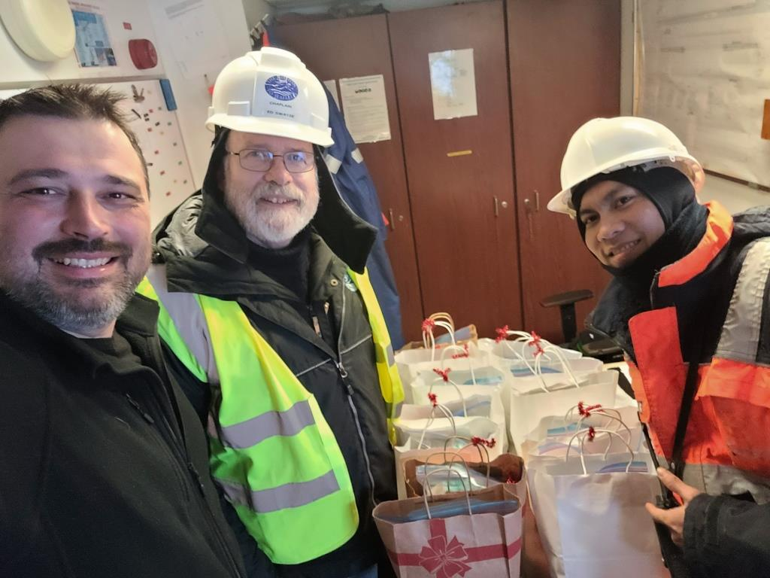

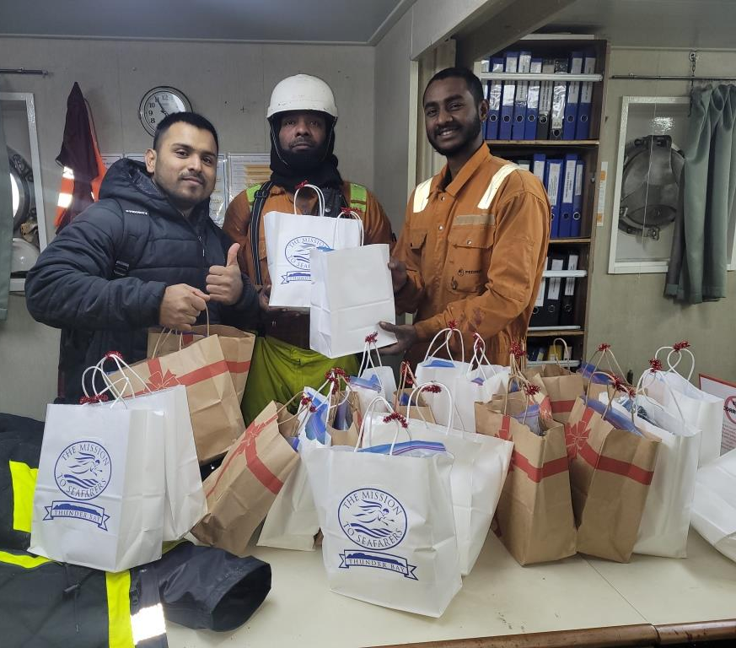
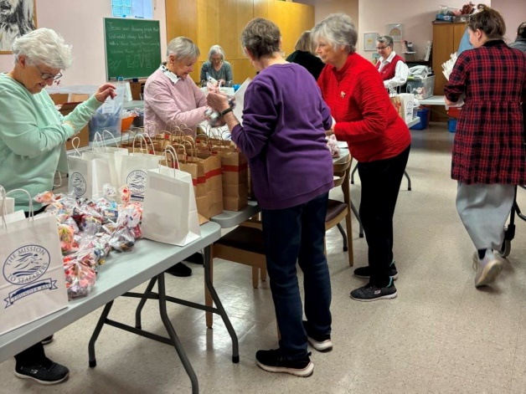
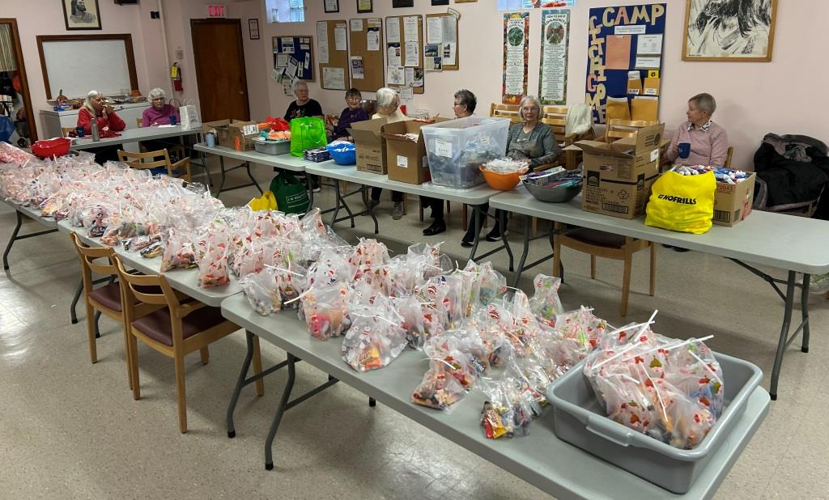
Christmas Gift Bags
Notes:
Gift Bags put together at St. Stephen’s

Slide 15
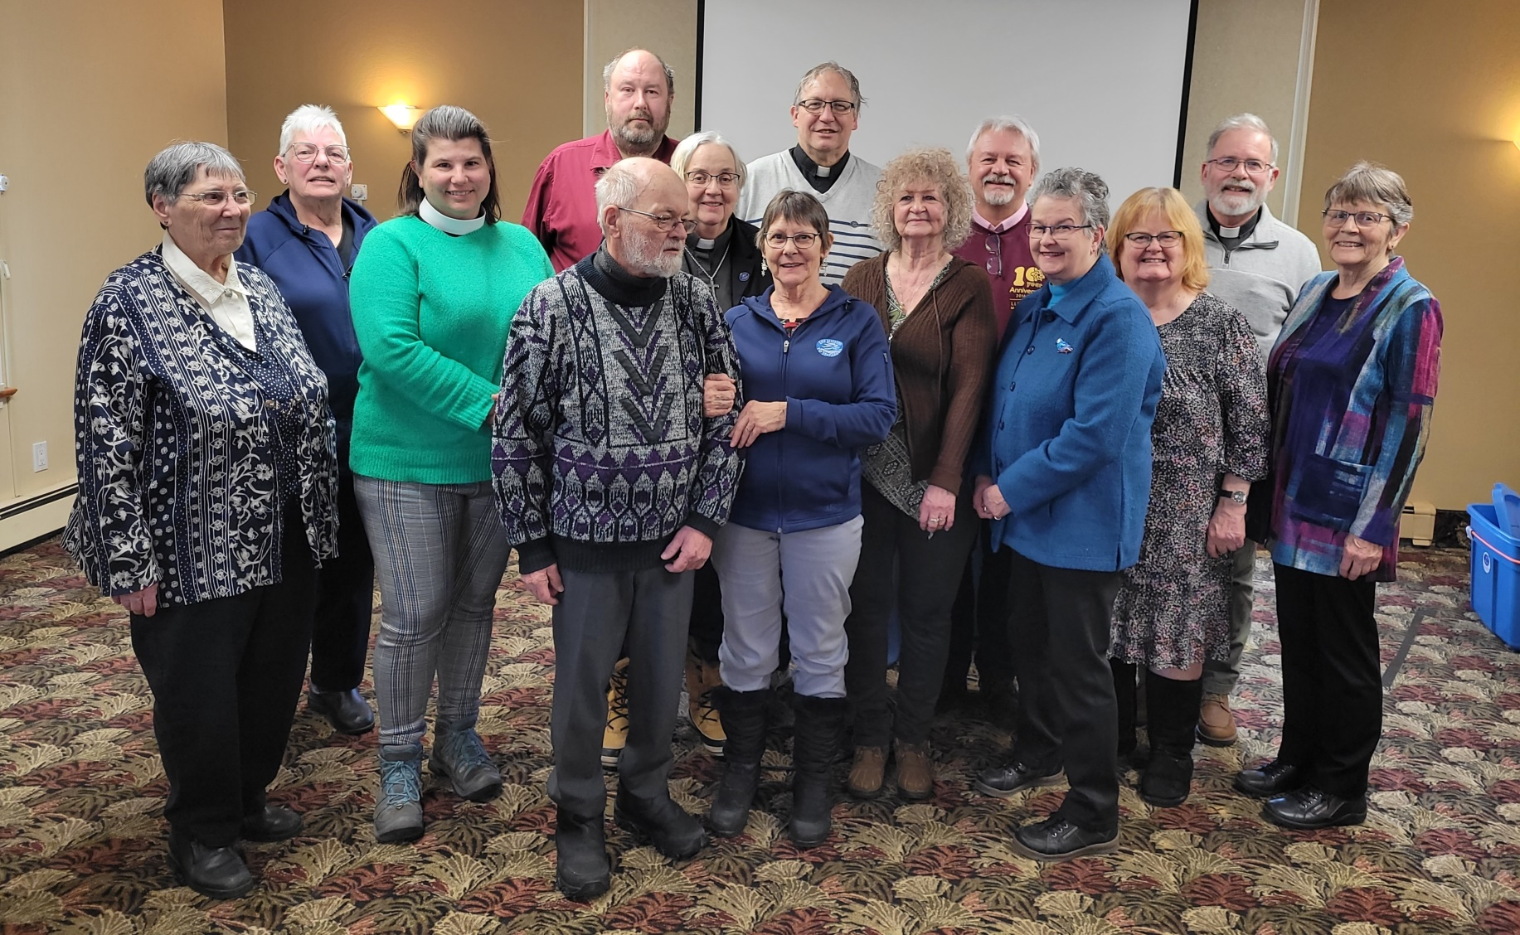
Volunteers

Slide 16
Volunteers
Working in an industrial environment
Security
  ensure authorized staff and volunteers have access to port facilities
Safety
  Has the Mission done everything reasonable to ensure that our staff, volunteers and seafarers in our care
  are safe?
Notes:
Policies
Protective equipment
Training

Slide 17
Volunteers
 | # days
Operations | 205
Seafarers’ Centre | 34
Administration | 37
Community Building & Fundraising | 37
Total | 313
Notes:
2023

Slide 18
Volunteer Training
Training | Tasking
Session #1 Getting Started | All Driver/Watch Keepers
Port Tour | All Driver/Watch Keepers Start as a Driver/Watch Keeper
Session #2 Transporting Seafarers | All Driver/Watch Keepers Necessary to provide transportation for medical care and crew change
Session #3 Petty Cash Short Procedure | All Driver/Watch Keepers
Volunteer OJT Form | All Driver/Watch Keepers
Session #4 Assisting Seafarers | All Driver/Watch Keepers
Session #5 Ship Visitor | Necessary for Ship Visitor to start visiting ships
Session #6 Person-in-Charge | Person-in-Charge
Petty Cash Exercise | Ship Visitor and Person-in-Charge; optional for Driver/Watch Keeper
Ship Welfare Visitor Course | Ship Visitor to complete while ship visiting
Standard First Aid | Optional

Slide 19
Way ahead

Slide 20
2026 Plans
Newsletter
Update History
Renew Ministry Plan

Slide 21
Looking Ahead
Role of Treasurer vacant
  Several volunteers working as Assistant Treasurers
  Chaplain working in the role of Treasurer
Volunteers needed
  3 Driver/Watch Keepers

Slide 22
Christmas Gift Bags
Donations need to be at the Seafarers Centre by November 23 (2nd last Monday)
Goal 304 bags for 16 ships
mittens/gloves; toque; socks; neck warmer; playing cards, hand-held games/puzzles; small tool: flashlight, screwdriver; | toothbrush toothpaste disposable razors (other toiletries are not needed); chap stick; and individually wrapped chocolate.
Notes:
Volunteers make up bags
Use financial donations to purchase extras

Slide 23
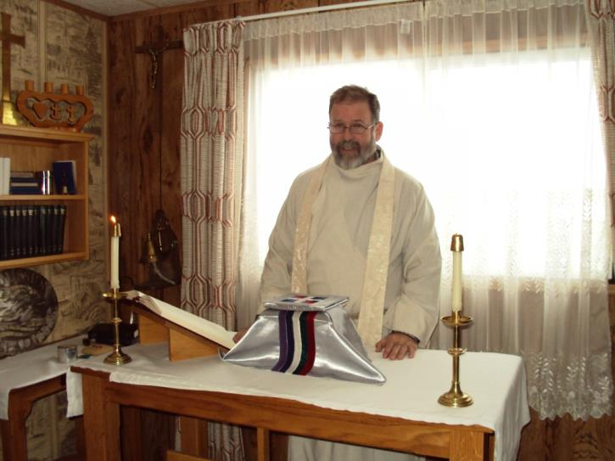
1st Wednesday of the Month
12:10 p.m. Eucharist and lunch
  Not held in January

Slide 24
Events
Annual General Meeting
  At the Seafarers’ Centre
  Wednesday, June 3, 2026
  Meeting at 11:30 am
  Zoom link available
  Lunch follows AGM

Slide 25
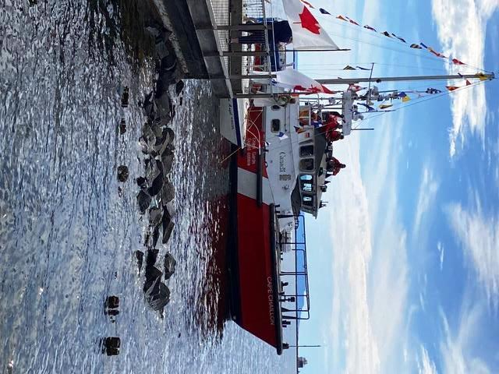
Events
Blessing of the Fleet
  10:30 am Saturday
  June 20, 2026

Slide 26
Events
Open House
  At the Seafarers’ Centre
  Sunday, October 18, 2026
  1:30 pm to 3:00 pm

Slide 27
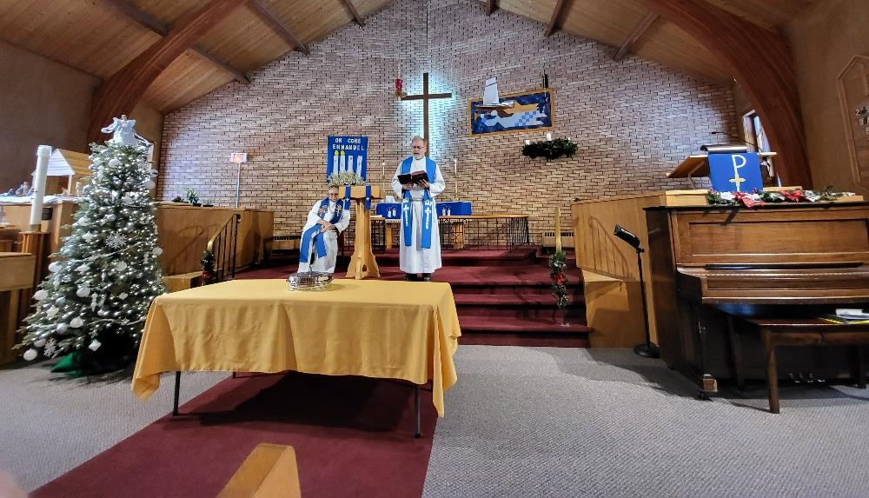
St. Nicholas’ Day
11:00 am December 2, 2026
Notes:
Anniversary of founding of Thunder Bay’s Station on December 6, 1961 St. Nicholas’ Day celebrated in December

Slide 28
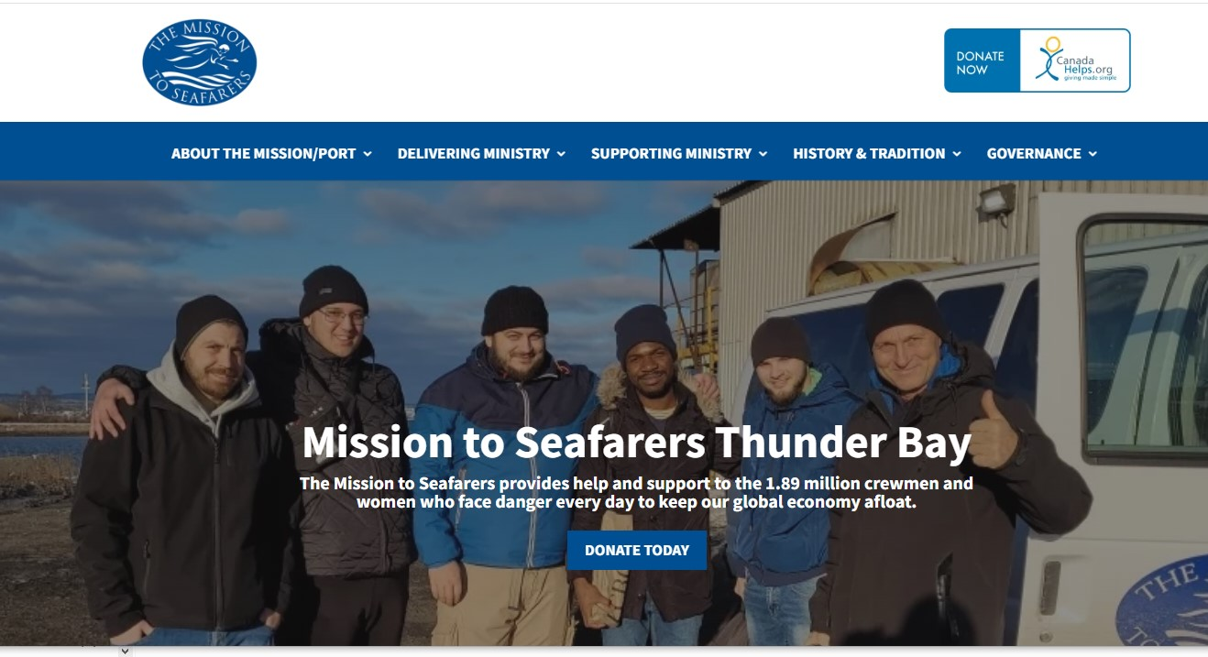
Website
  www.missiontoseafarersthunderbay.ca

Slide 29
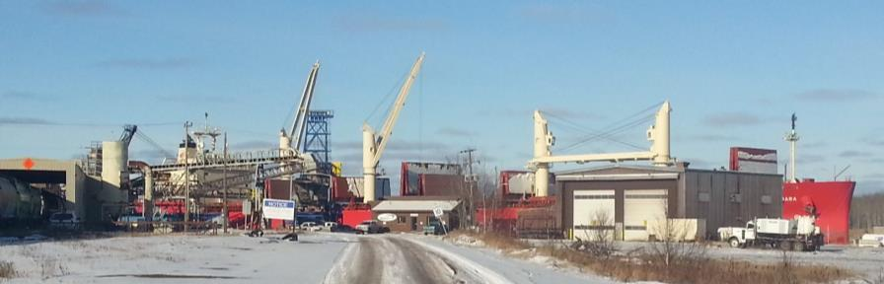
Financial Donations
The Mission to Seafarers: Port of Thunder Bay is a registered charity
To donate:
  Electronic Offering Program (EOP)
  through the Diocese of Algoma
  CanadaHelps.org
  by cheque
  Interac
  Etransfer
Notes:
Federal Nagara at MobilEx

Slide 30
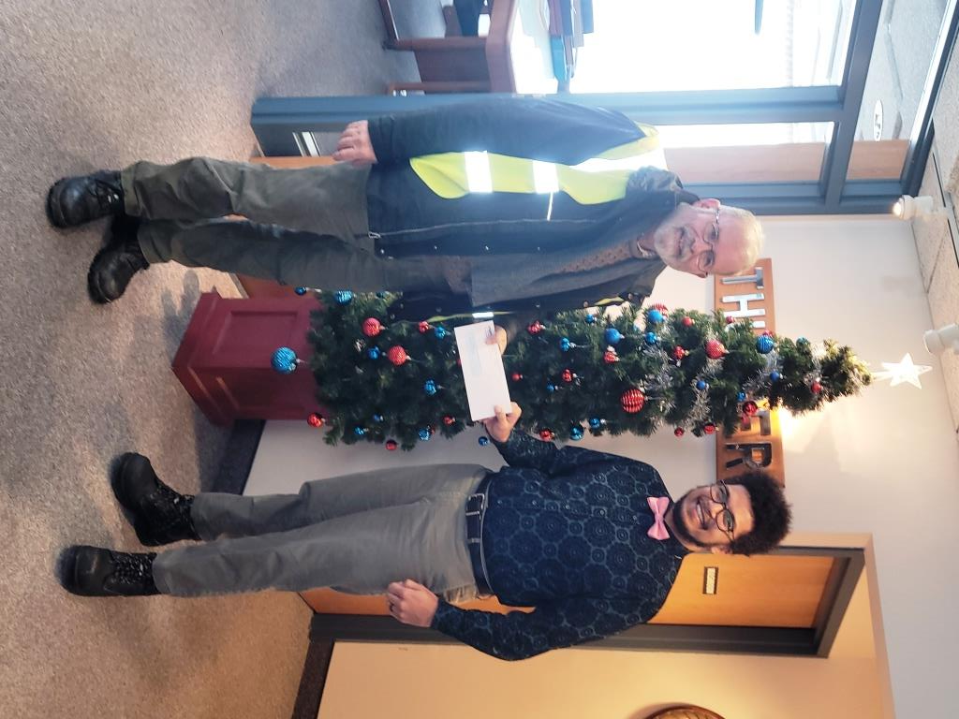
Thank you
The Mission to Seafarers would like to thank all of our supporters; and
our MASTER Donors:
  Anglican Diocese of Algoma
  Thunder Bay Port Authority
  International Sailors Society
  of Canada
  FedNav

Slide 31

For further information
www.missiontoseafarersthunderbay.ca
  Vessel Report
  Constitution & By-laws
  Worship Resources
  External Links
  www.facebook.com
  /missiontoseafarerstbay
Notes:
send a donation and be put on our mailing list to receive a newsletter once a year

